Slide 1
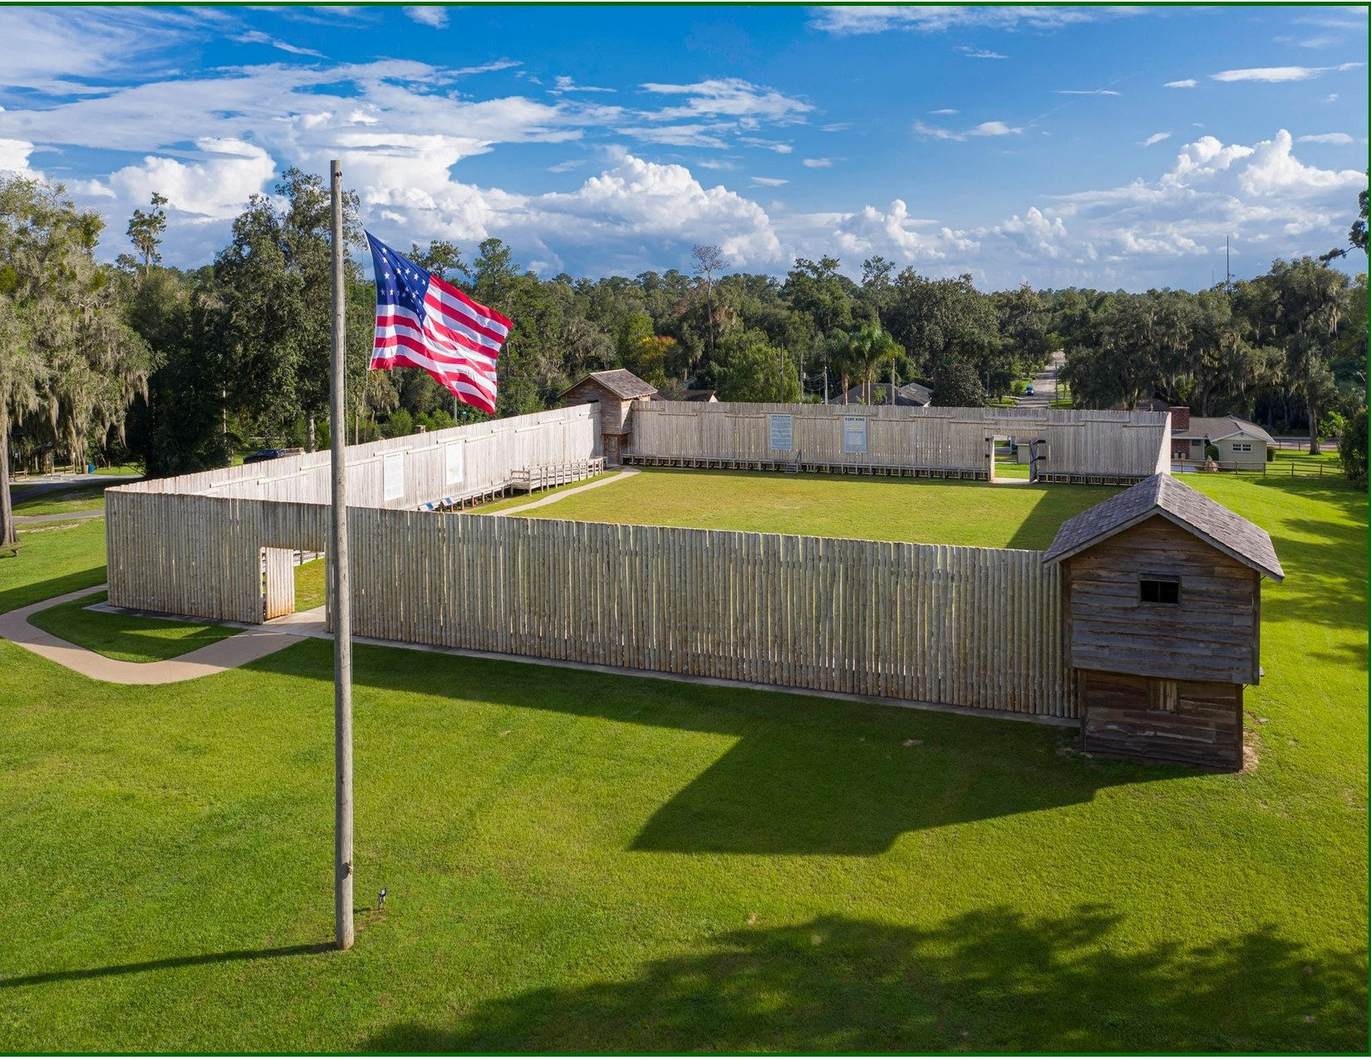
FORT KING

Slide 2
CHRONOLOGY OF
HISTORIC
FORT KING

Slide 3
1826 - Gad Humphries constructs the first Seminole Indian Agency in what is now
Ocala, FL
1827 - Fort King is built to administrate the Treaty of
Moultrie Creek. Relocation of Seminoles to a large reservation in Central Florida.

Slide 4
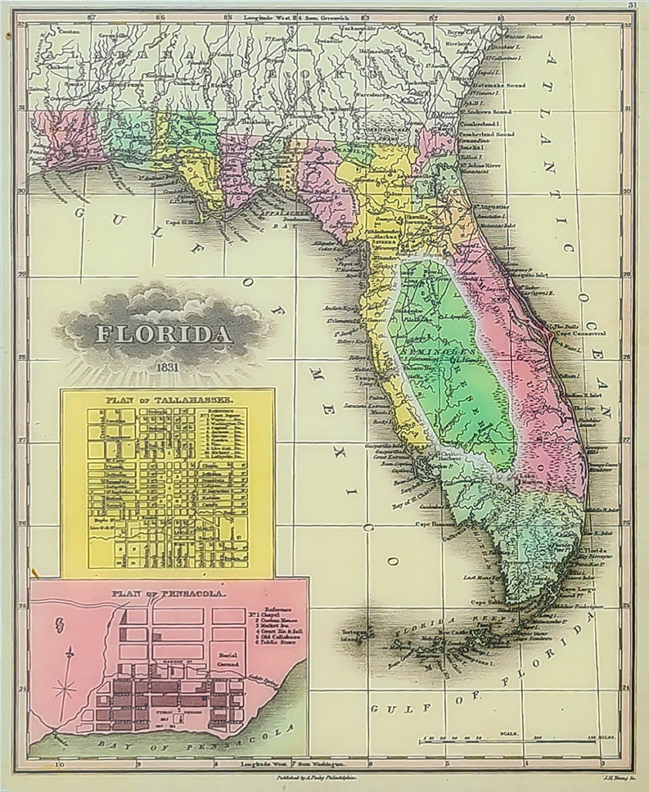
1829 - As the recession of 1829 worsened, the army
abandoned Fort King due to severe budget cuts.
1832 - Payne’s Landing Treaty enforced
by the U.S. Army, requiring the Seminole
to give up their Florida lands and move
west.

Slide 5
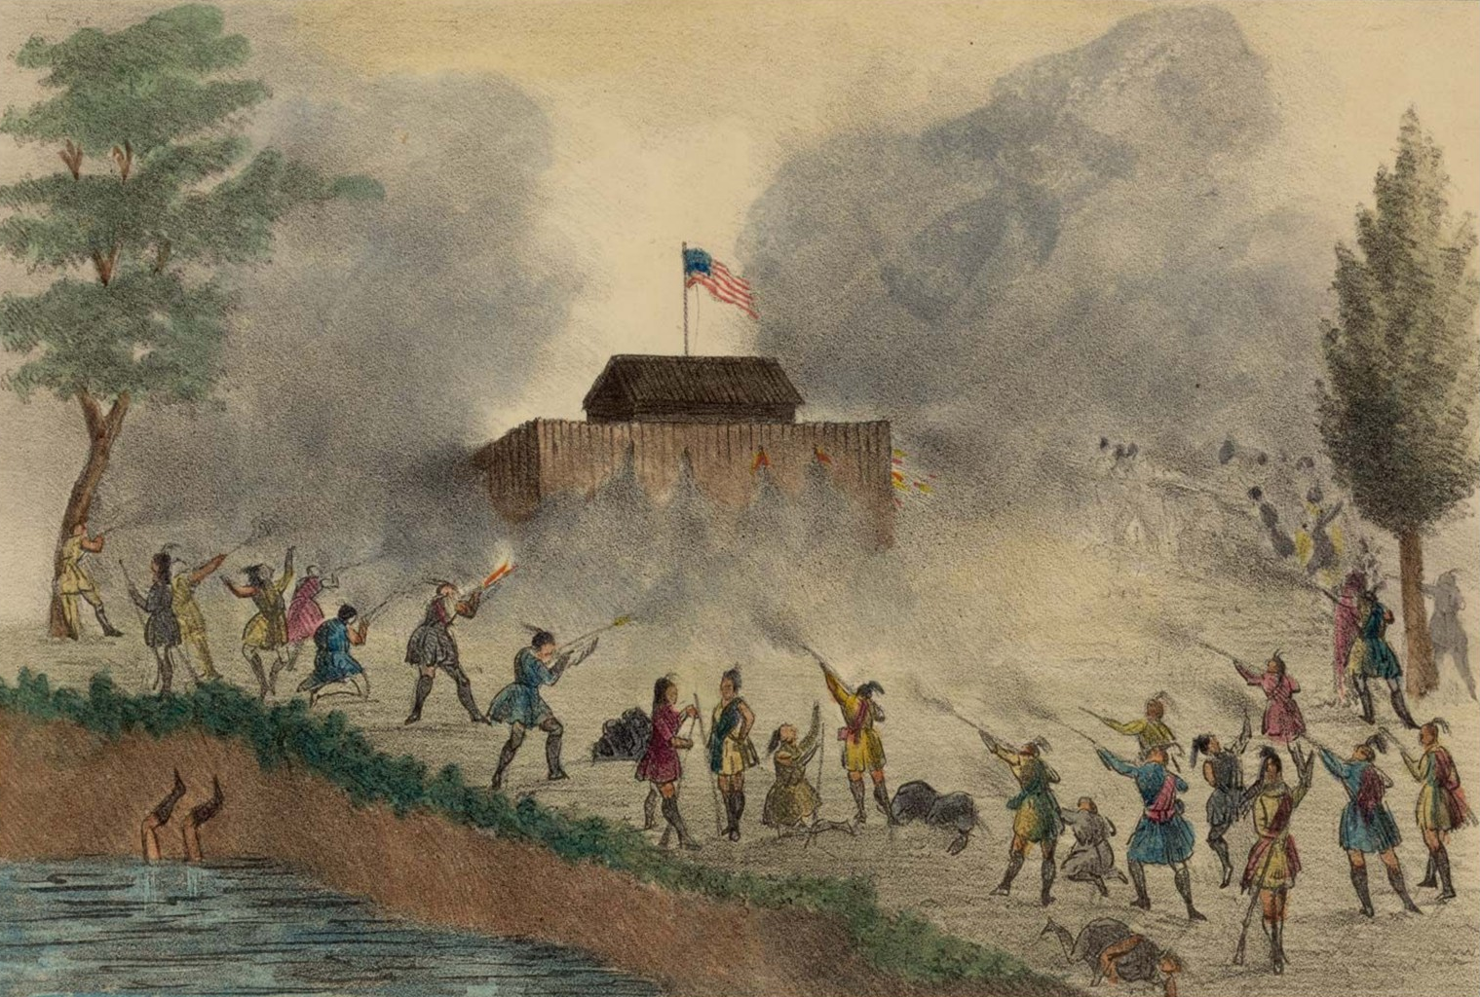

Slide 6
1835 - Wiley Thompson, Ft. King commanding officer and three others were killed by Seminole leader Osceola and 80 warriors at Fort King.
1835 - Dade Massacre marked the first day of the Second Seminole War.
#1 Giver 2024

Slide 7
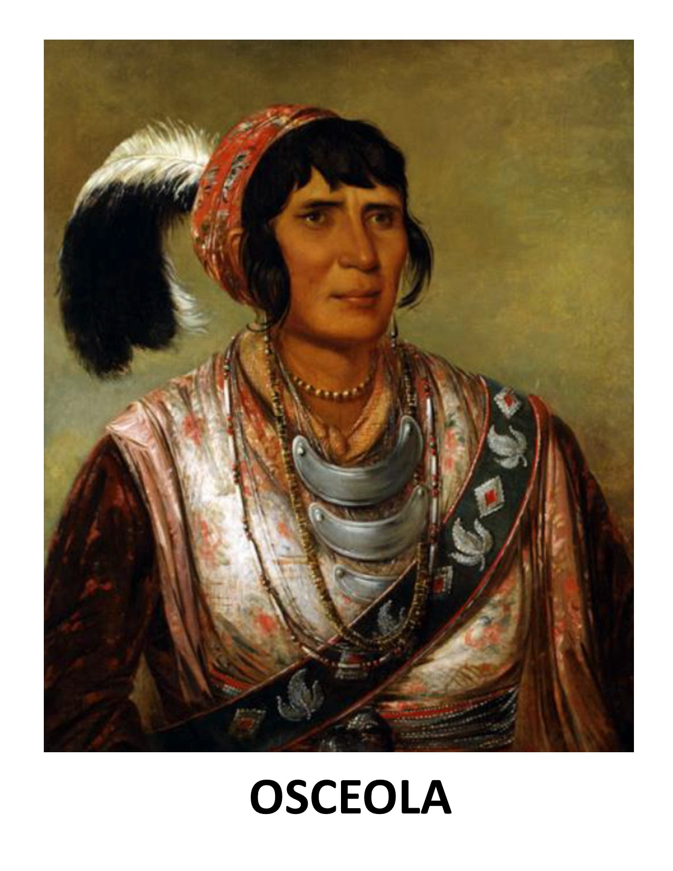
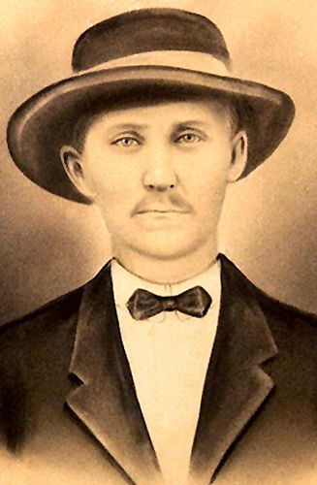
WILEY THOMPSON

Slide 8
1836 - The first fort was abandoned and burned to the ground by the Seminoles.
1837 - U.S. Army rebuilt the Fort
1840 - The last fighting takes place at Fort King with three soldiers killed.

Slide 9
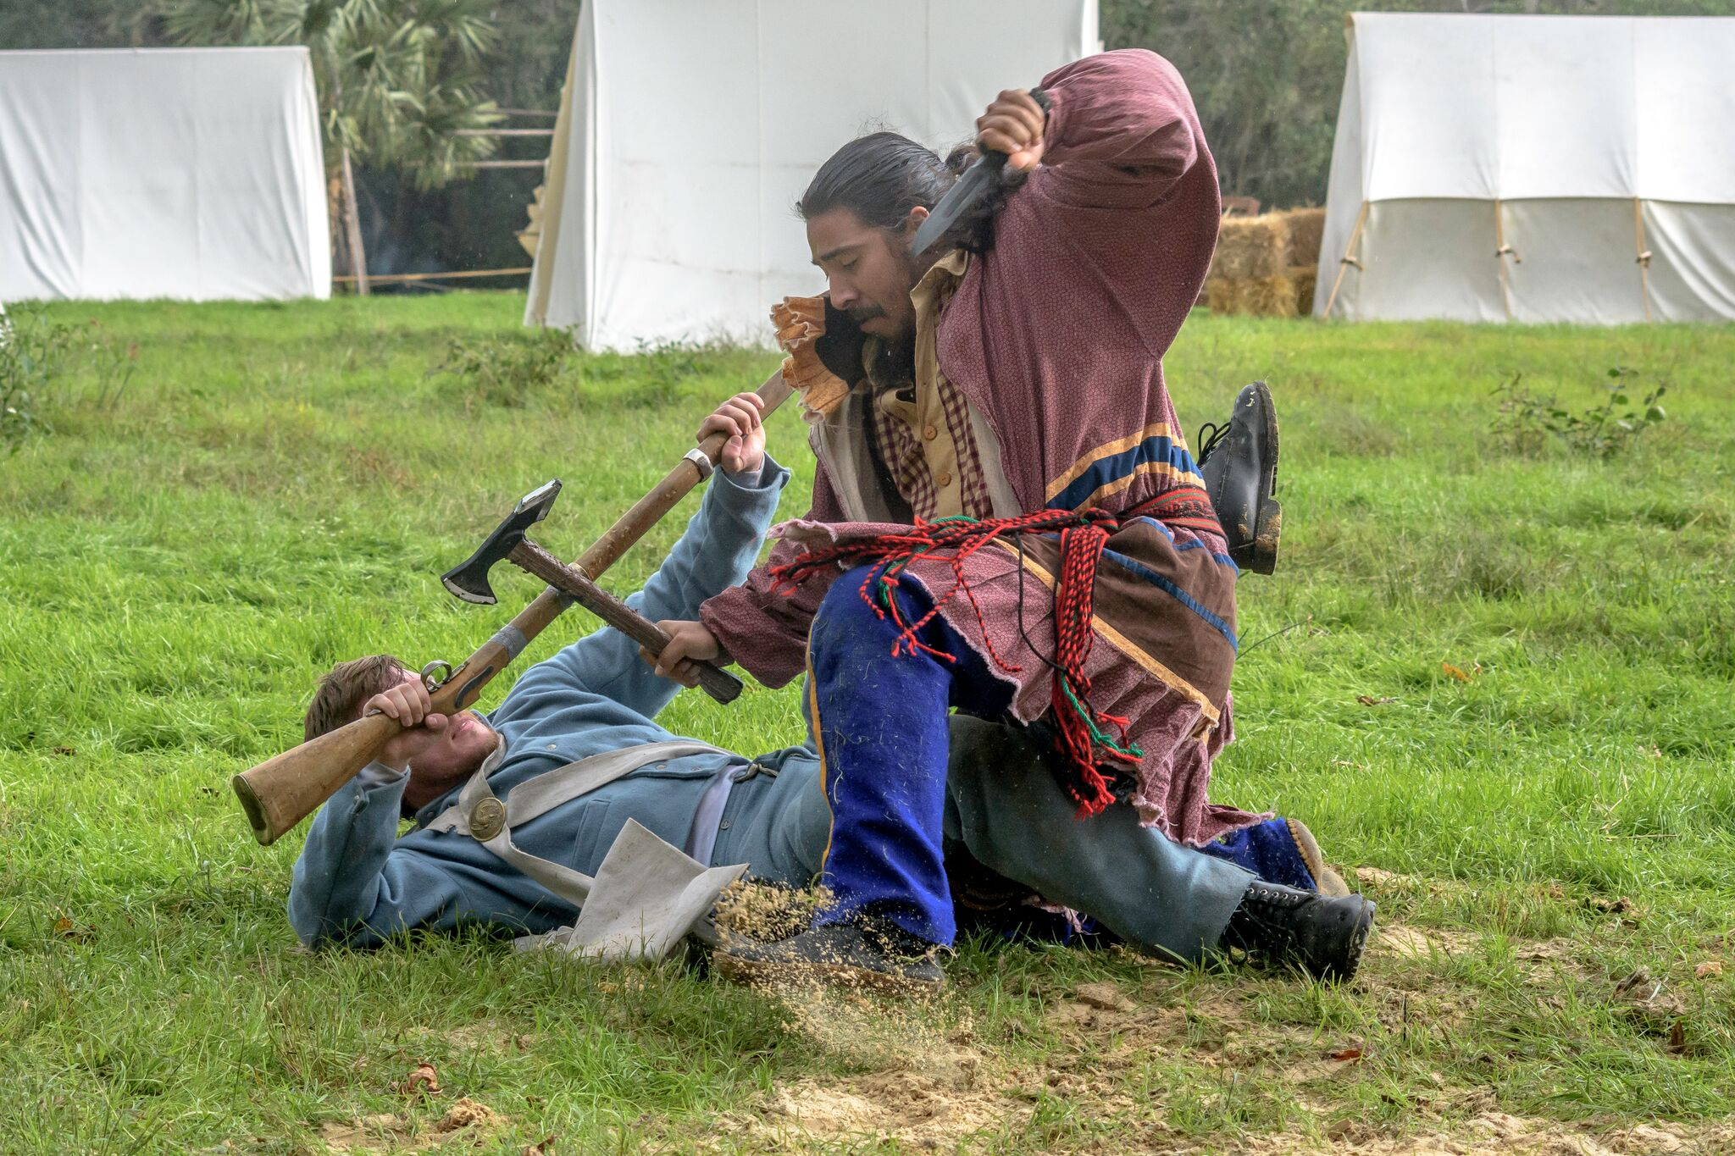

Slide 10
1842 - End of the Second Seminole War
1844 - Abandoned as a military base and became Marion County’s first courthouse and public building.
1846 - Settlers dismantle Fort King for its lumber.

Slide 11
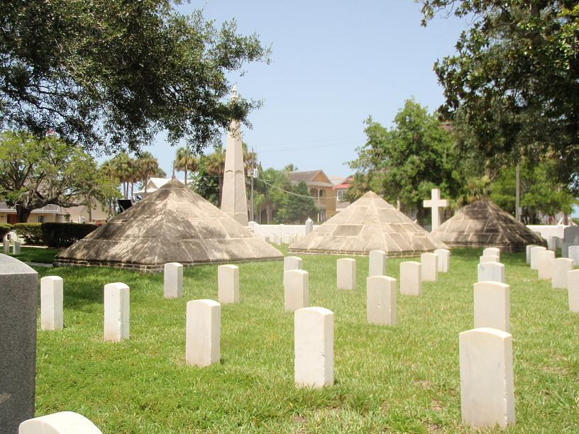
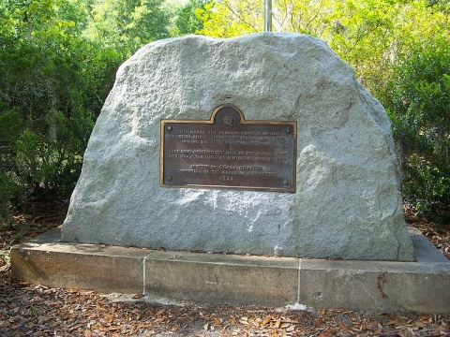
1927 - The DAR Ocala Chapter purchased the Soldier
Cemetery to begin community efforts to preserve
Fort King.
DAR MONUMENT, Ocala, FL
ST. AUGUSTINE, FL CEMETERY

Slide 12
1987 - During research of Ocala’s land use plan, city staff
begins to realize the historical importance of the
site for Ocala, Marion County and the nation.
1992 - Marion County purchased the first 15 acre parcel
that comprises the greater Fort King site.

Slide 13
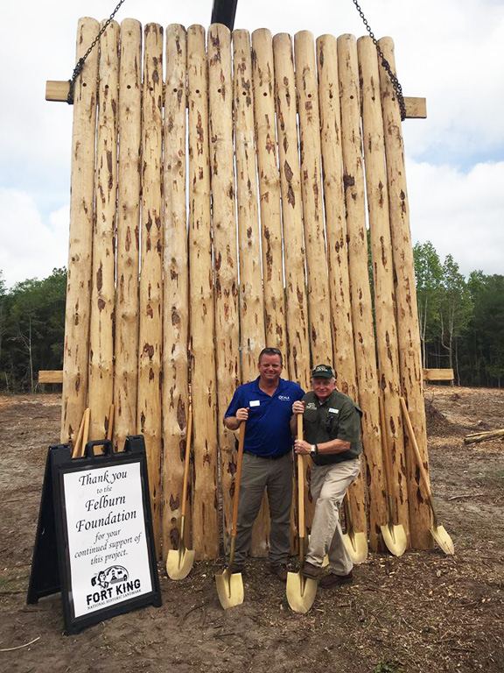
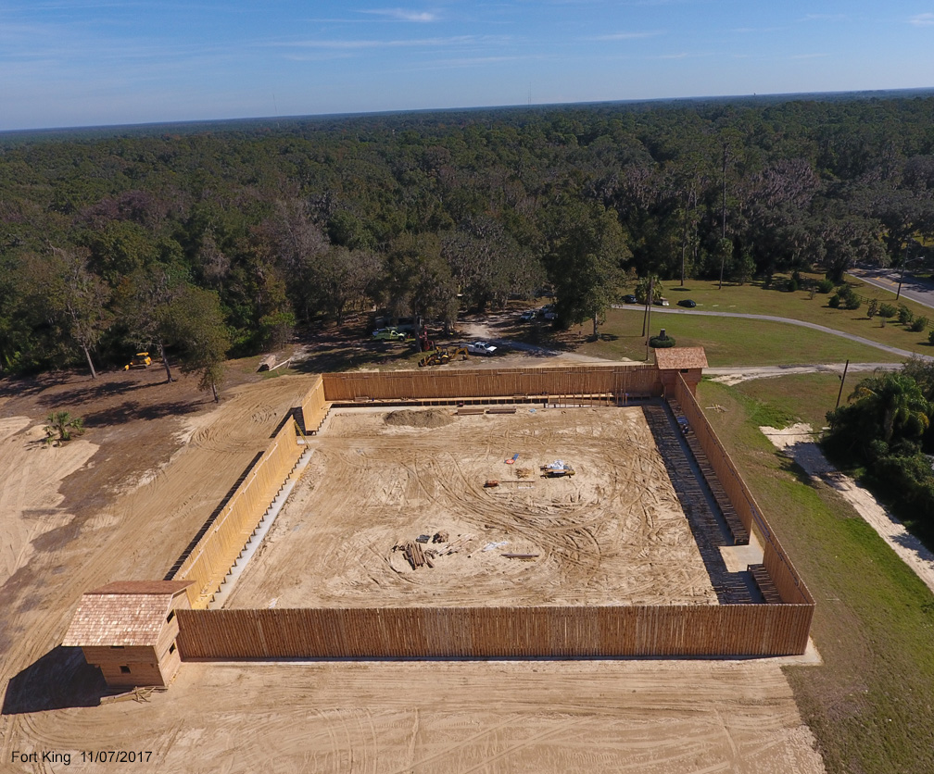

Slide 14
2001 - City of Ocala spearheaded local efforts to secure a
State of Florida grant to purchase the 22 acre
“McCall homestead” on which Fort King was
situated.
2004 - Designated a National Historic Landmark by the
National Park Service.
2014 - The park and visitor center were open to the public.

Slide 15
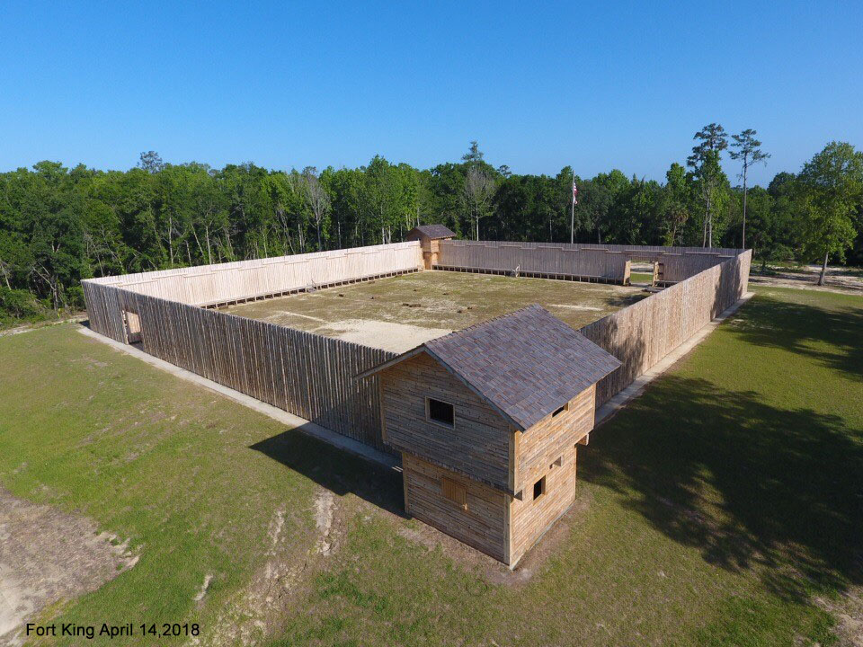

Slide 16
2015 - City of Ocala awarded State of Florida Division of
Historic Resources grant for replica of the fort
palisade walls and block houses.
2015 - FKHF expanded the park boundary with the
purchase of a parcel on the west peripheral with
funding assistance from Felburn Foundation.
2017 - First Phase of the fort reconstruction complete

Slide 17
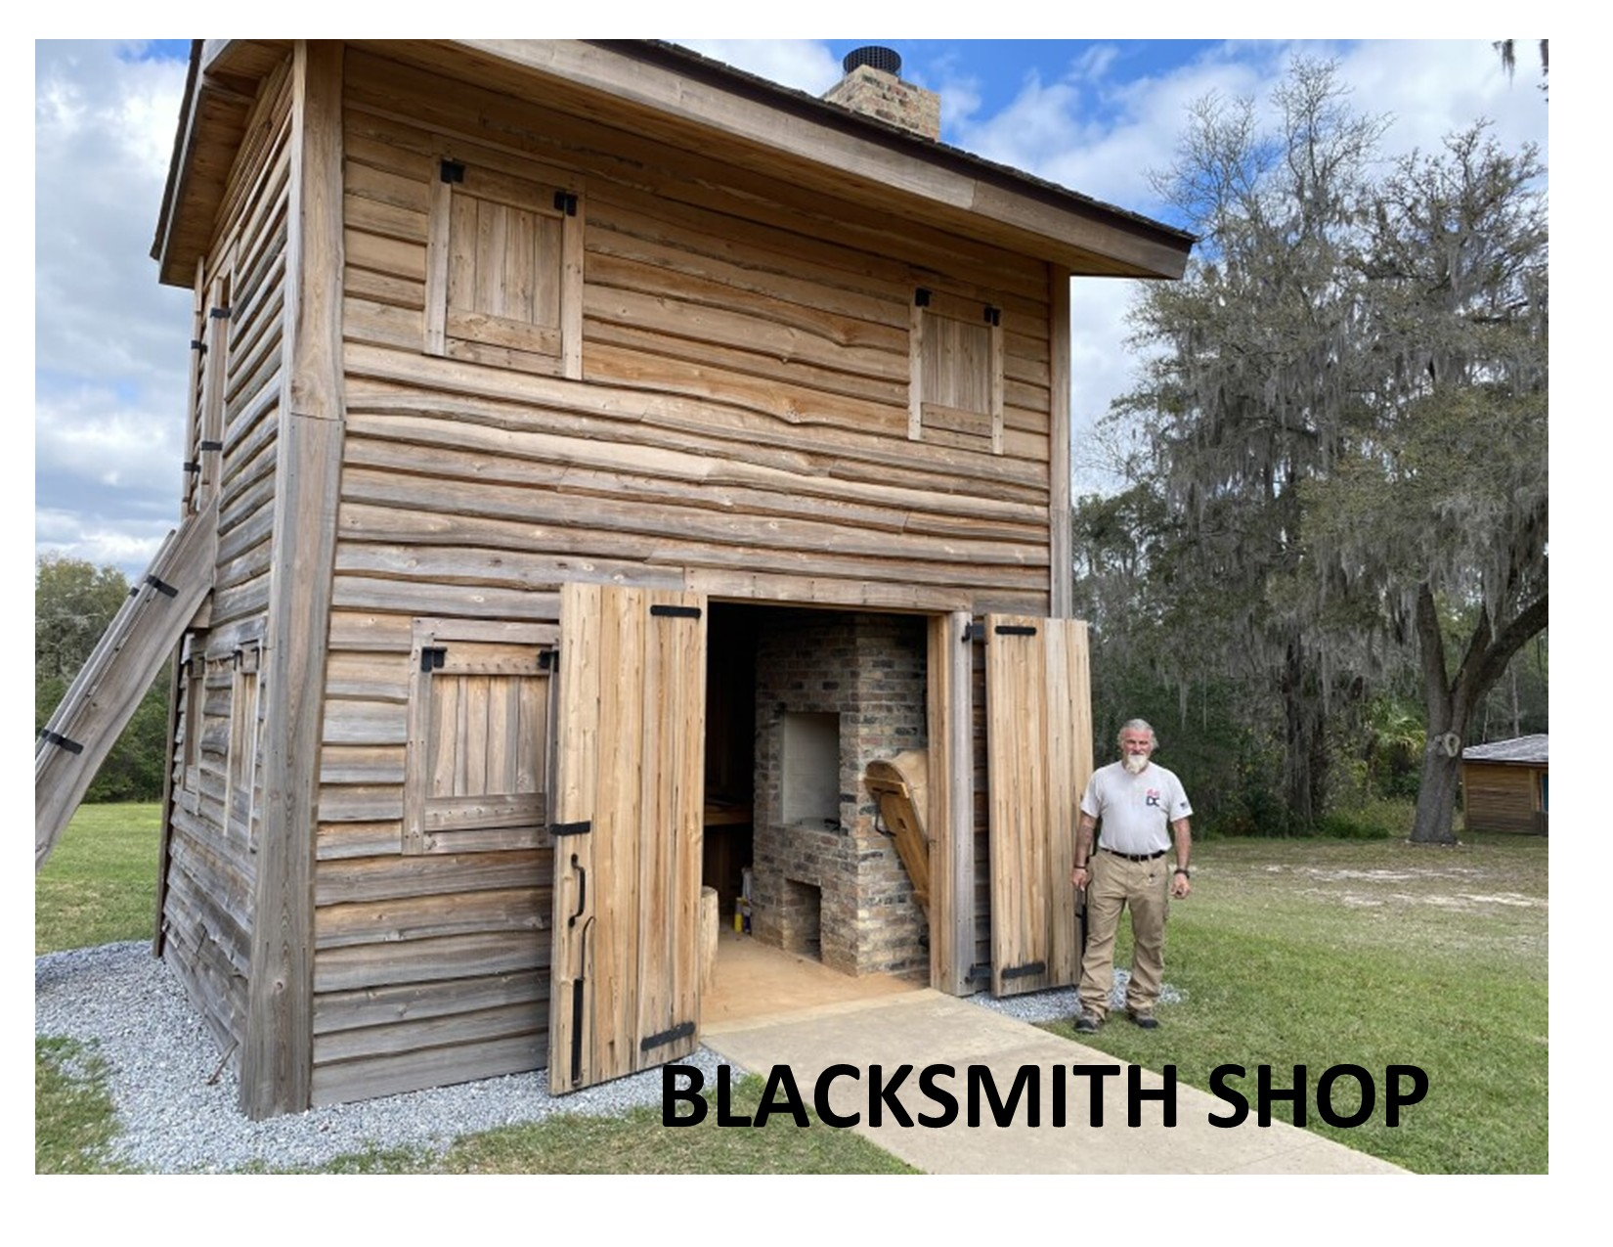

Slide 18
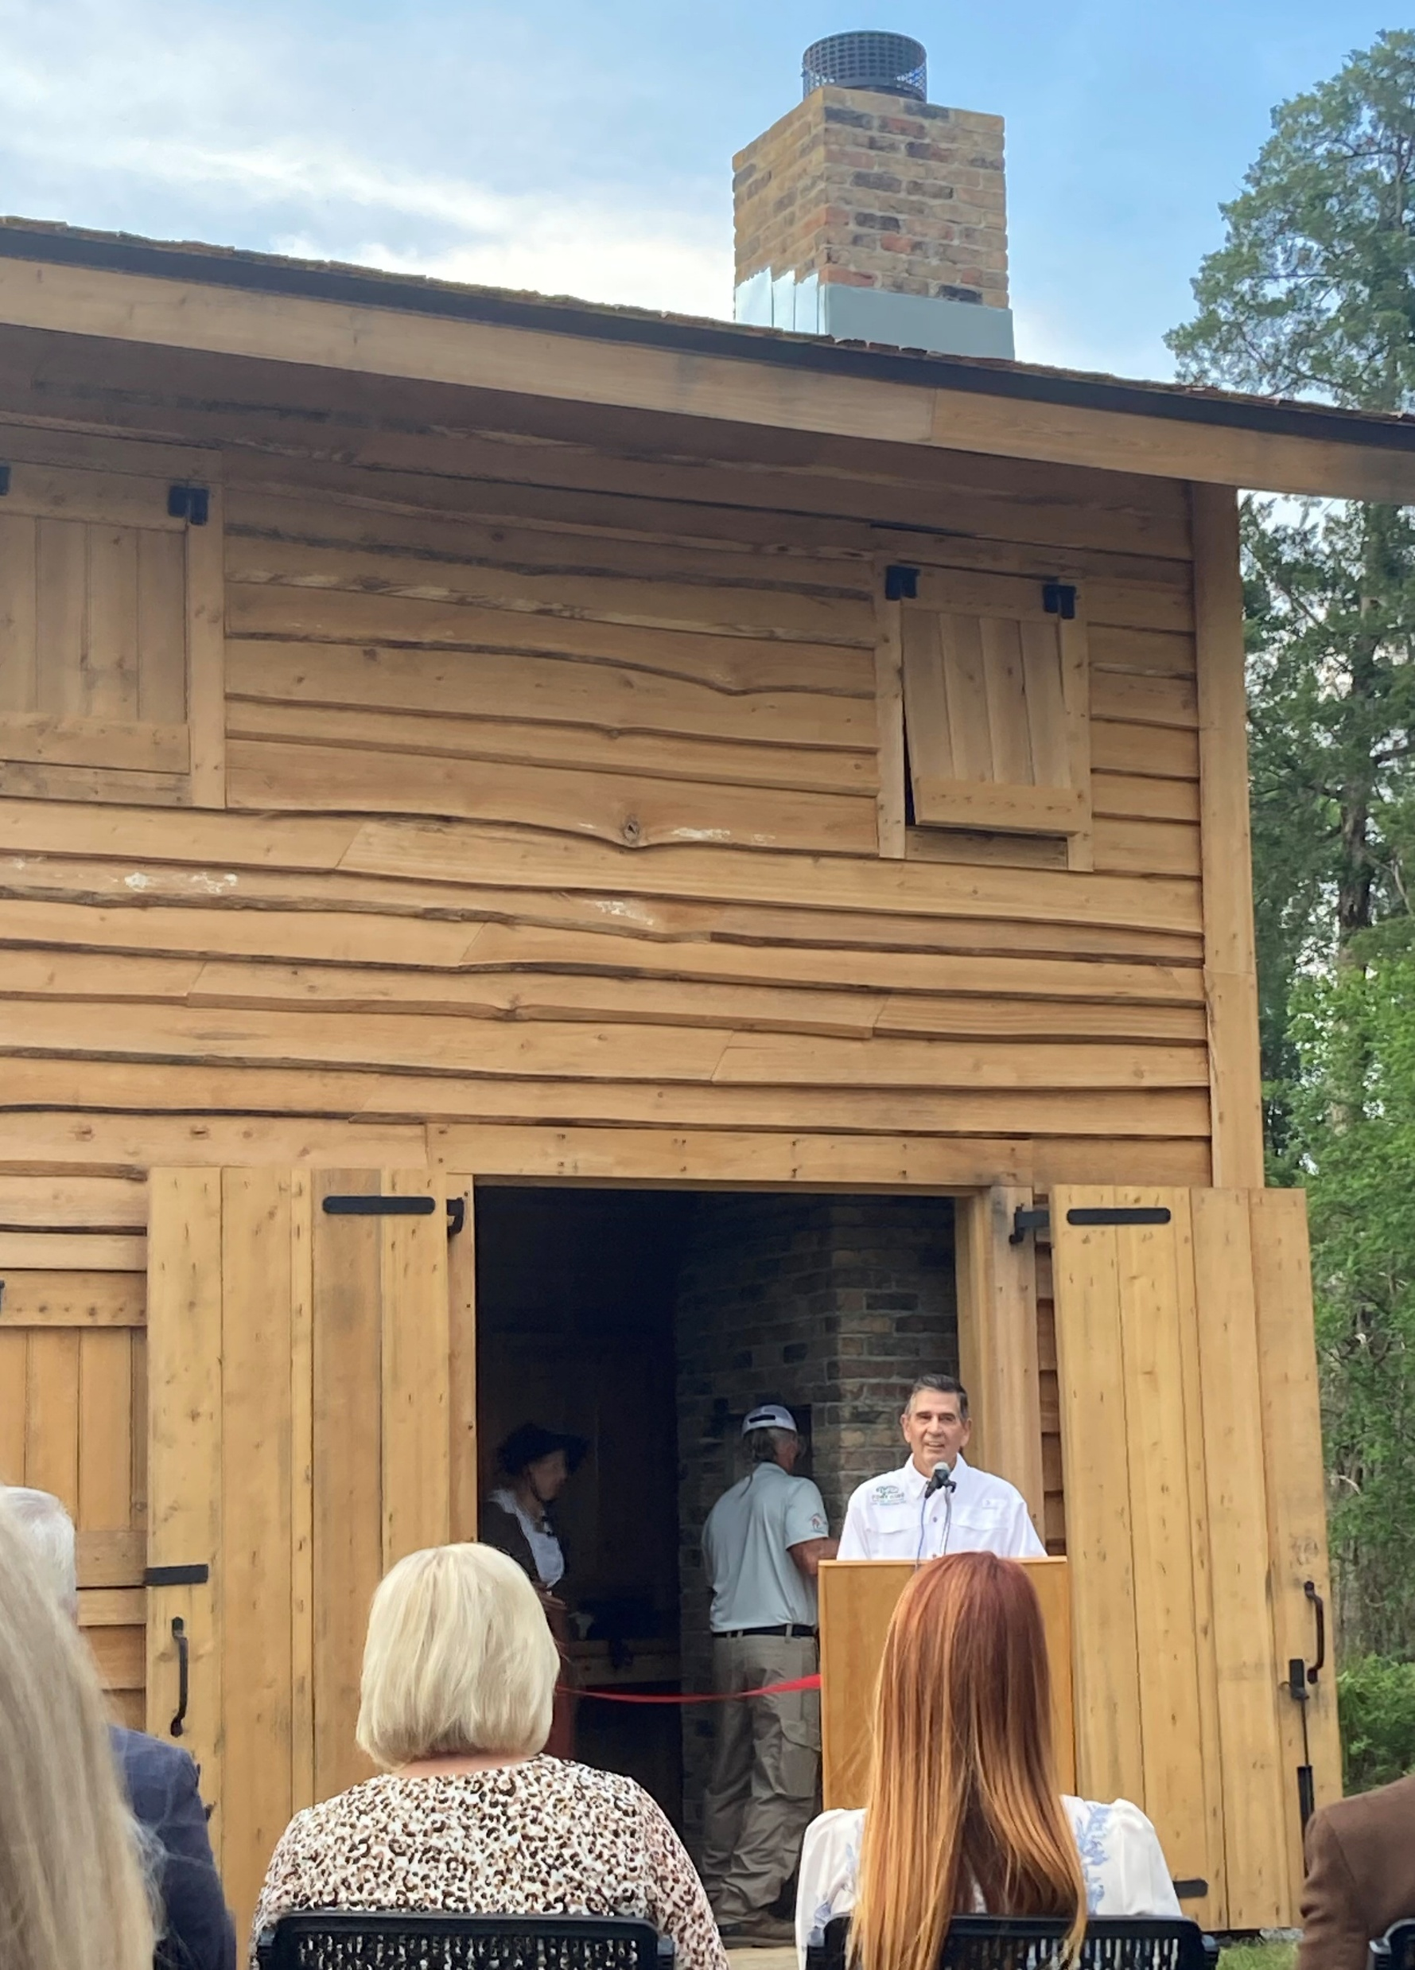
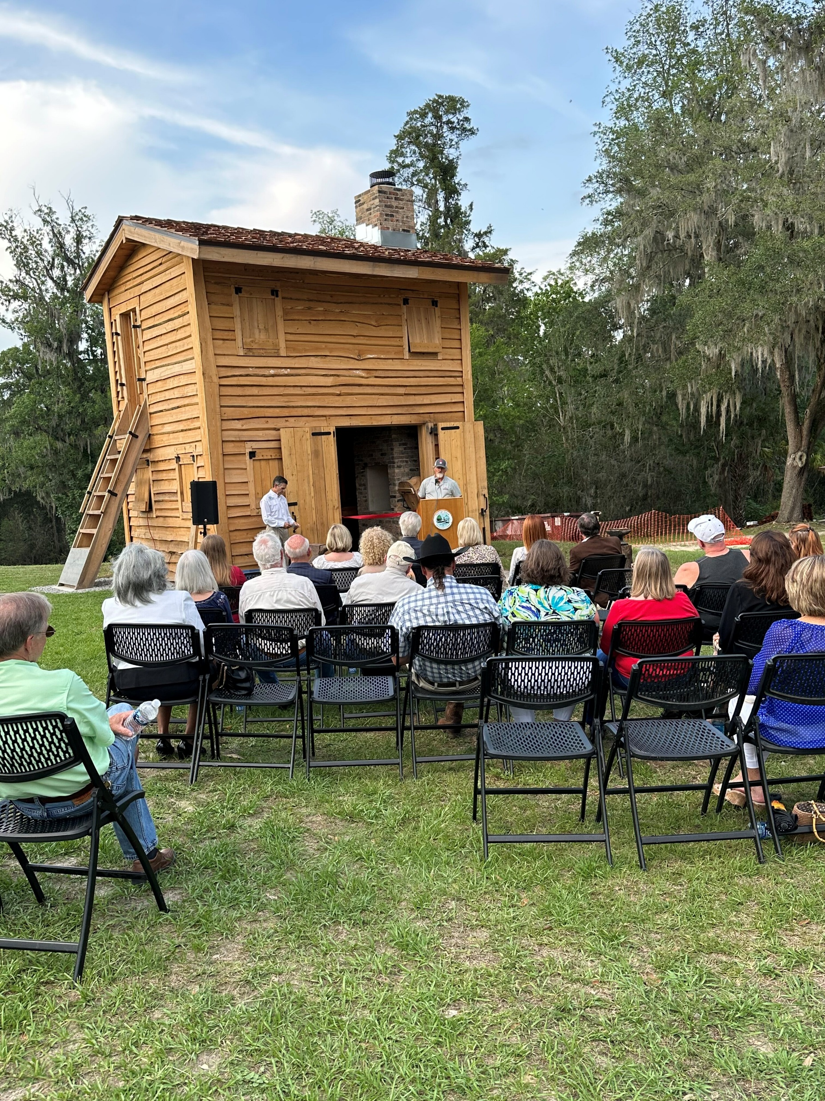
BLACKSMITH SHOP DEDICATION

Slide 19
2018 - Fort King Heritage Foundation presents a check to
the City of Ocala for the last invoice for
construction of Fort King. The Fort is constructed and paid for!
2019 - East parcel purchased for temporary Fort King
Archaeology Resource Center (City, County/TDC,
FKHF / Felburn Foundation).
A contract was signed for the blacksmith shop and archaeology work.
2023 - May 11 Fort King celebrated history with the dedication of the Blacksmith Shop.

Slide 20
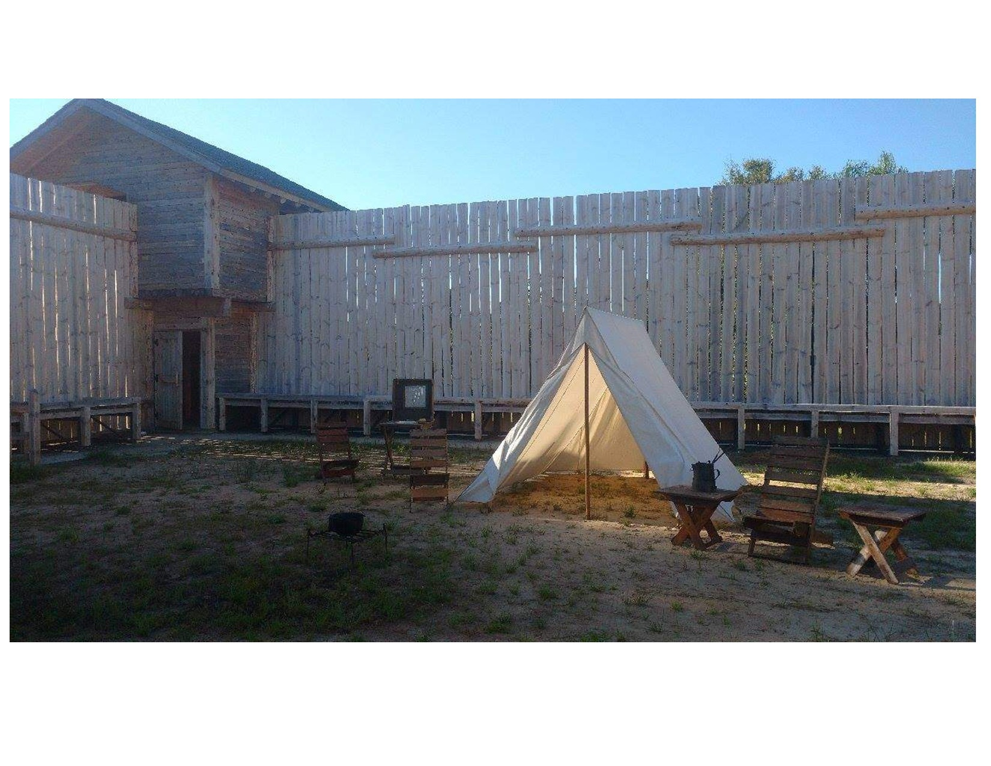

Slide 21
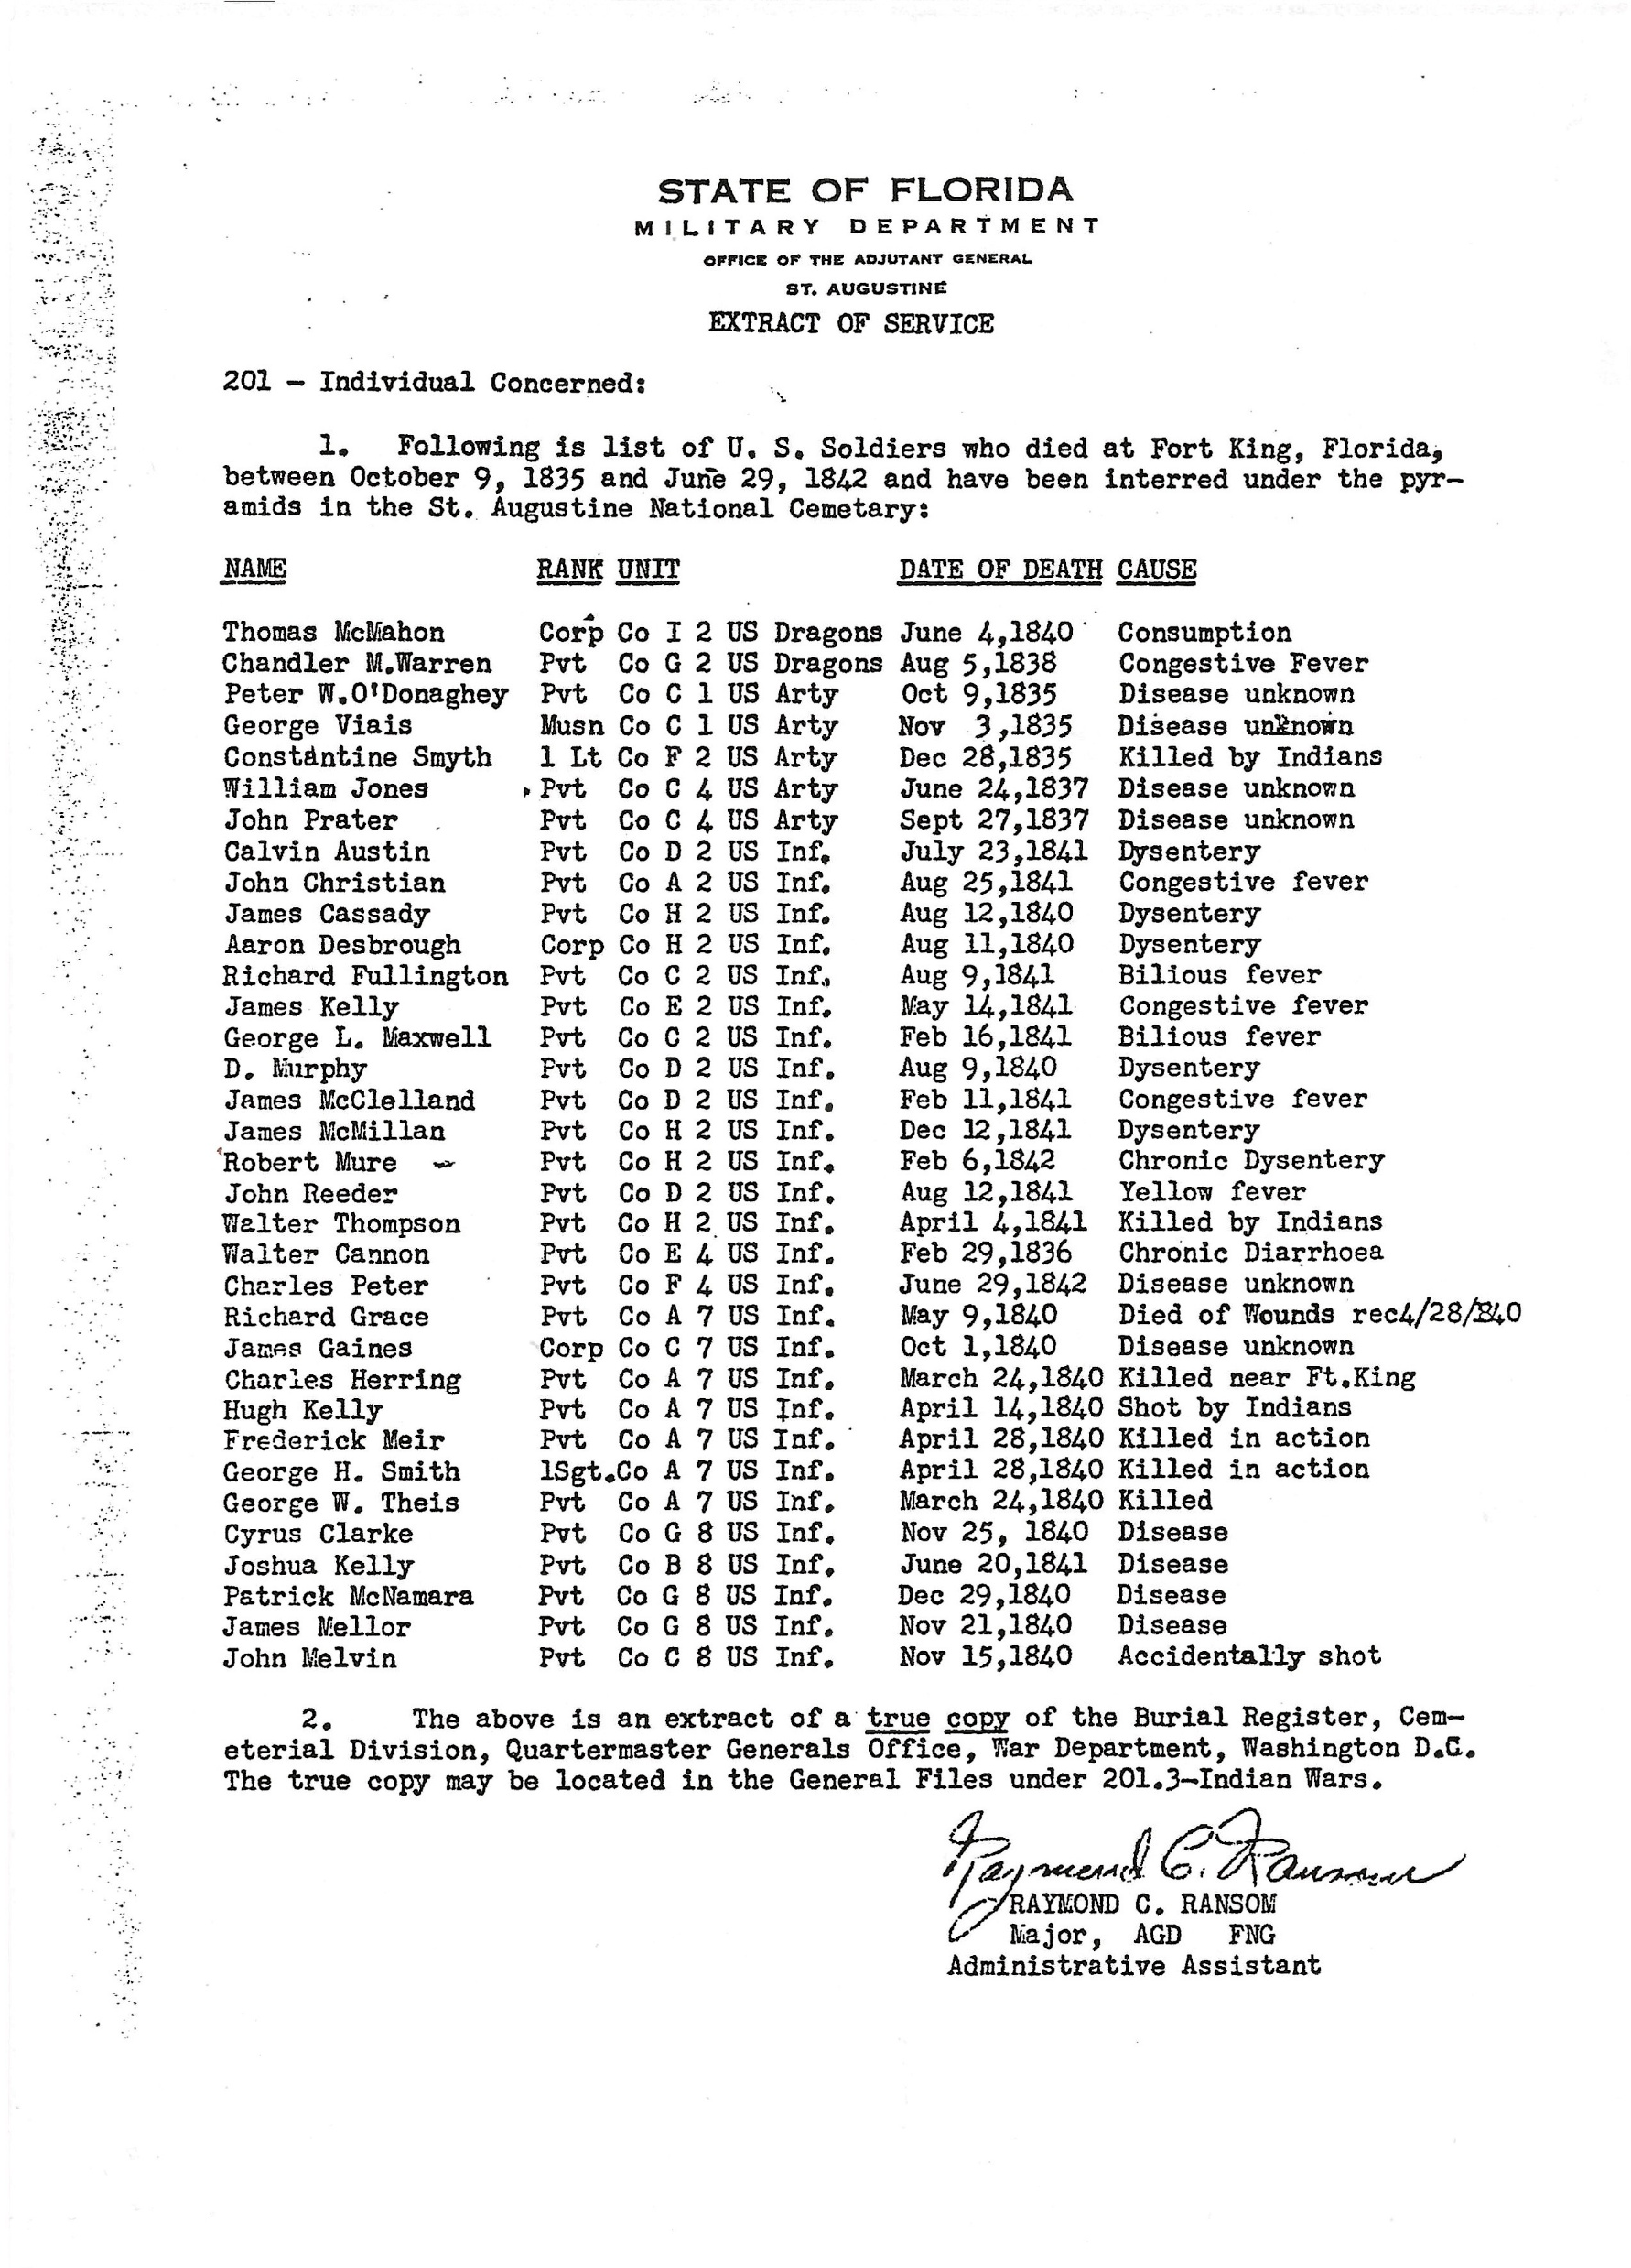
HOW THE SOLDIERS DIED

Slide 22
